Slide 1
Computer organization and architecture
Session – 2

Slide 2
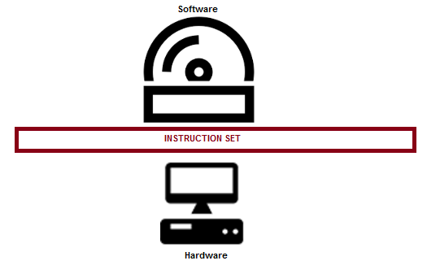
ISA – Instruction Set Architecture
Instruction Set Architecture, ISA, is an interface between the hardware and software and it is indeed playing the role of an instructor to instruct the hardware about what to be done through the software instructions.
In other words, ISA helps to utilize the hardware to its complete ability through the software instructions.
It is a mediator and acts as a frontier amid the software and hardware.

Slide 3
Contd.,
ISA helps in defining the operations, modes of operation supported, addressing, storage related inputs, how to use, perhaps, how to access the operands through instructions etc.
In short, or more precisely, one could say that, a processor is detailed through the instruction set architecture.
There are many processors and there could be many ISAs.
The ISA would support multiple instructions and instruction types based on the processor selected.
The instructions specified by the ISA shall be well interpreted by the processor and corresponding action shall be initiated. ISA is a collection of instructions and formats supported for the processor. Through ISA, i.e. instructions one can access the resources.

Slide 4
Contd.,
A = B + C (ADD A, B, C)
Where,
A has the result of the operation
B and C are the operands which are to be added. (B and C are called registers, which has values inside)
“+” is the operation, i.e. addition.
“=” is the assignment operation, after the expression is evaluated, the result shall be assigned to A.
The same addition expression mentioned above shall be accomplished through the instruction ADD A, B, C where B and C are the source registers with A being the destination register.

Slide 5
Contd.,
Now, it is ISA’s role shall come here in deciding the following very important considerations.
What is the operation to be performed?
Where to store the operands?
Where to store the result of the operation?
How many operands are needed to perform (this) operation?
Does the ISA support the operation specified? (For an instance 8085 does not support multiplication and division).
What is the type of the operation? (it can be classified, reader shall be introduced to this)
What is the format of the operation?
Size of the operands.
What are the addressing modes supported? How to address the operands?

Slide 6
Types of ISA – An understanding
Some call it classes, some call it types.
We can retain the term types of ISA for the discussion purpose. There are four types of ISA.
They are listed as follows, one after another.
Accumulator
Stack
Register (General purpose)
Register (Load and Store)

Slide 7
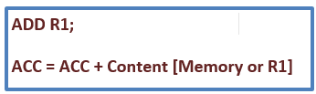
Contd.,
Accumulator:
This is normally referred as 1-address type of ISA and it is also a register.
In this approach, the content from a memory location or a specified register shall be added with the content available in the accumulator register and the result obtained shall also be stored back into the accumulator.
Here, in this approach, accumulator is the main component and carries more focus. This approach is accumulator centric.

Slide 8
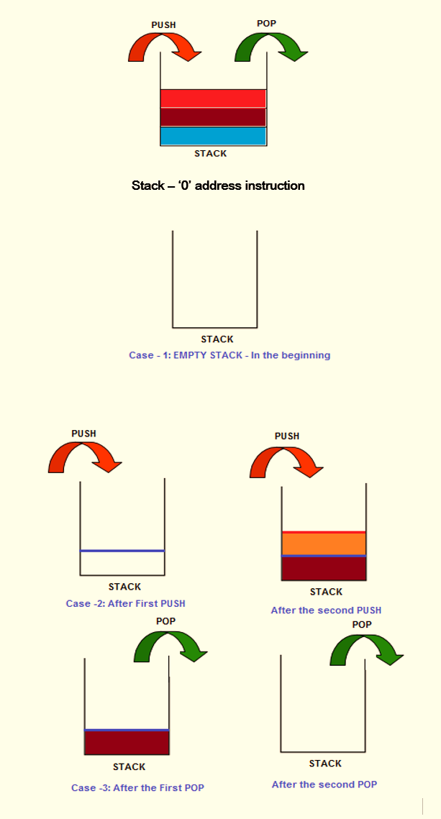
Contd.,
Stack:
This is often regarded as 0 address instruction.
Here, the user need not have to mention any operand and the instruction is operand less.
Means, a PUSH instruction shall push the content into the stack and POP shall pop the content out from the stack to a register.
The contents shall be added to the stack through the reference to the top of the stack.
The instructions to be remembered are “PUSH and POP”. This is a very simple approach and effective too.

Slide 9
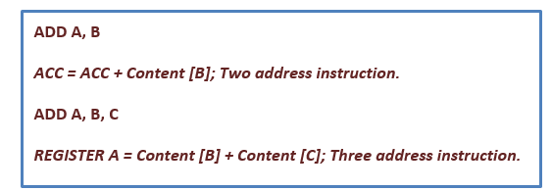
Contd.,
Register: (general purpose approach)
This is an approach where, general purpose registers shall be involved in the operation.
Here, in this approach the contents from the registers (operands) shall be used and when the result is available shall be stored in another register.
It could even be accumulator to store the result.
Here, there are two options. One, there can be 2 operands.
Secondly, there can be three operands.

Slide 10
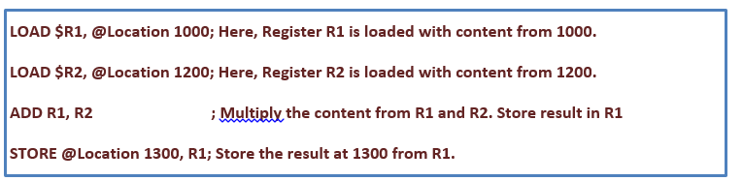
Contd.,
Register (Load and Store)
This ISA will demand the operands to be moved to the registers and only then the operation can be carried out.
For an instance, if you want to add two numbers, first, the two numbers (operands) should be stored in the registers and then the ALU can be fed with the input.
LOAD is used to move the data from the memory location to registers and STORE does it reverse.
Anything and everything in this approach shall be done through the registers and no direct memory access is encouraged.
This is what is referred as “RISC” architecture.
It can be represented as 2-address or 3 - address instruction based on the requirement.

Slide 11
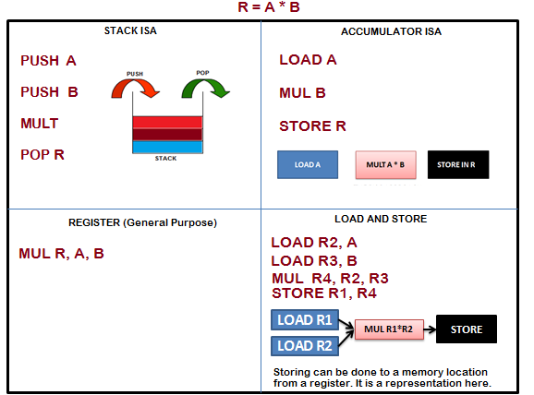
Contd.,
Expression to be implemented with all the four ISA types: R = A *B

